Slide 1



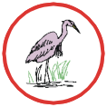



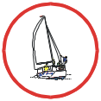

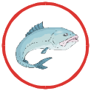










Key
Shell Fishery
Saltmarsh/Mangrove
Nesting Birds
Wading Birds
National Nature Reserve
Sea Birds
Marine Mammals
Marine Leisure
Leisure/Tourism
Fishery
Mammal Haul-out
Tidal Reference Point
Fish Farm
Building/Structure
Rocky Shoreline
Track
Road
Sandy Shoreline
Pipeline
Sheltered/Mud Shoreline
Depth 10mtr or less
Shingle/Mixed Shoreline
Cliffs
Depth 20mtr or less

